Slide 1
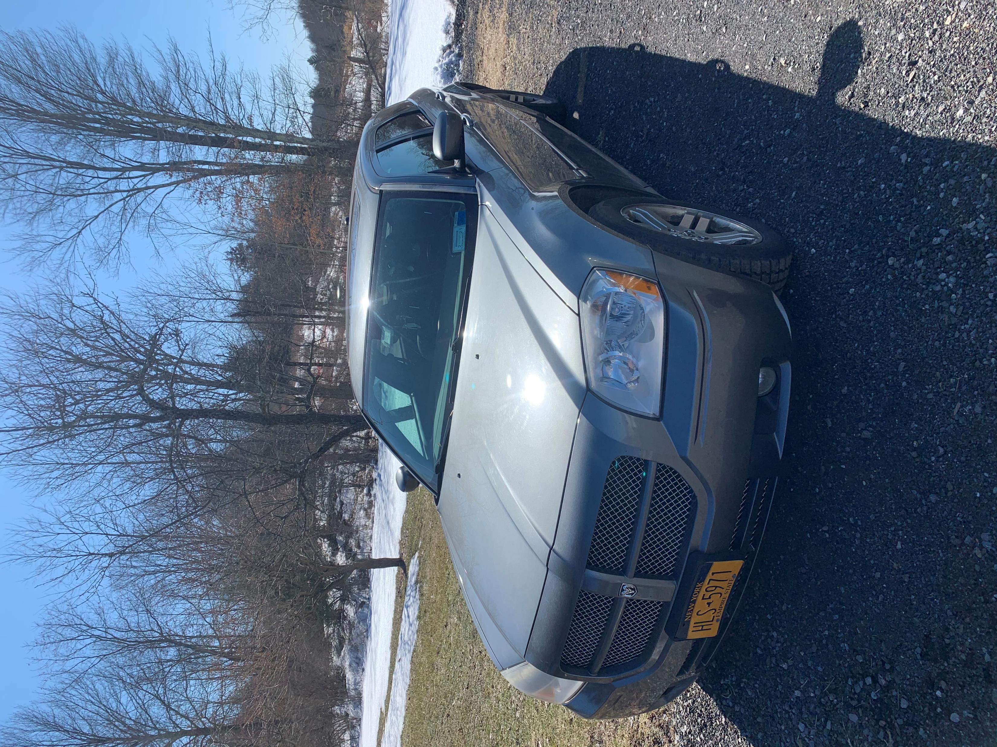
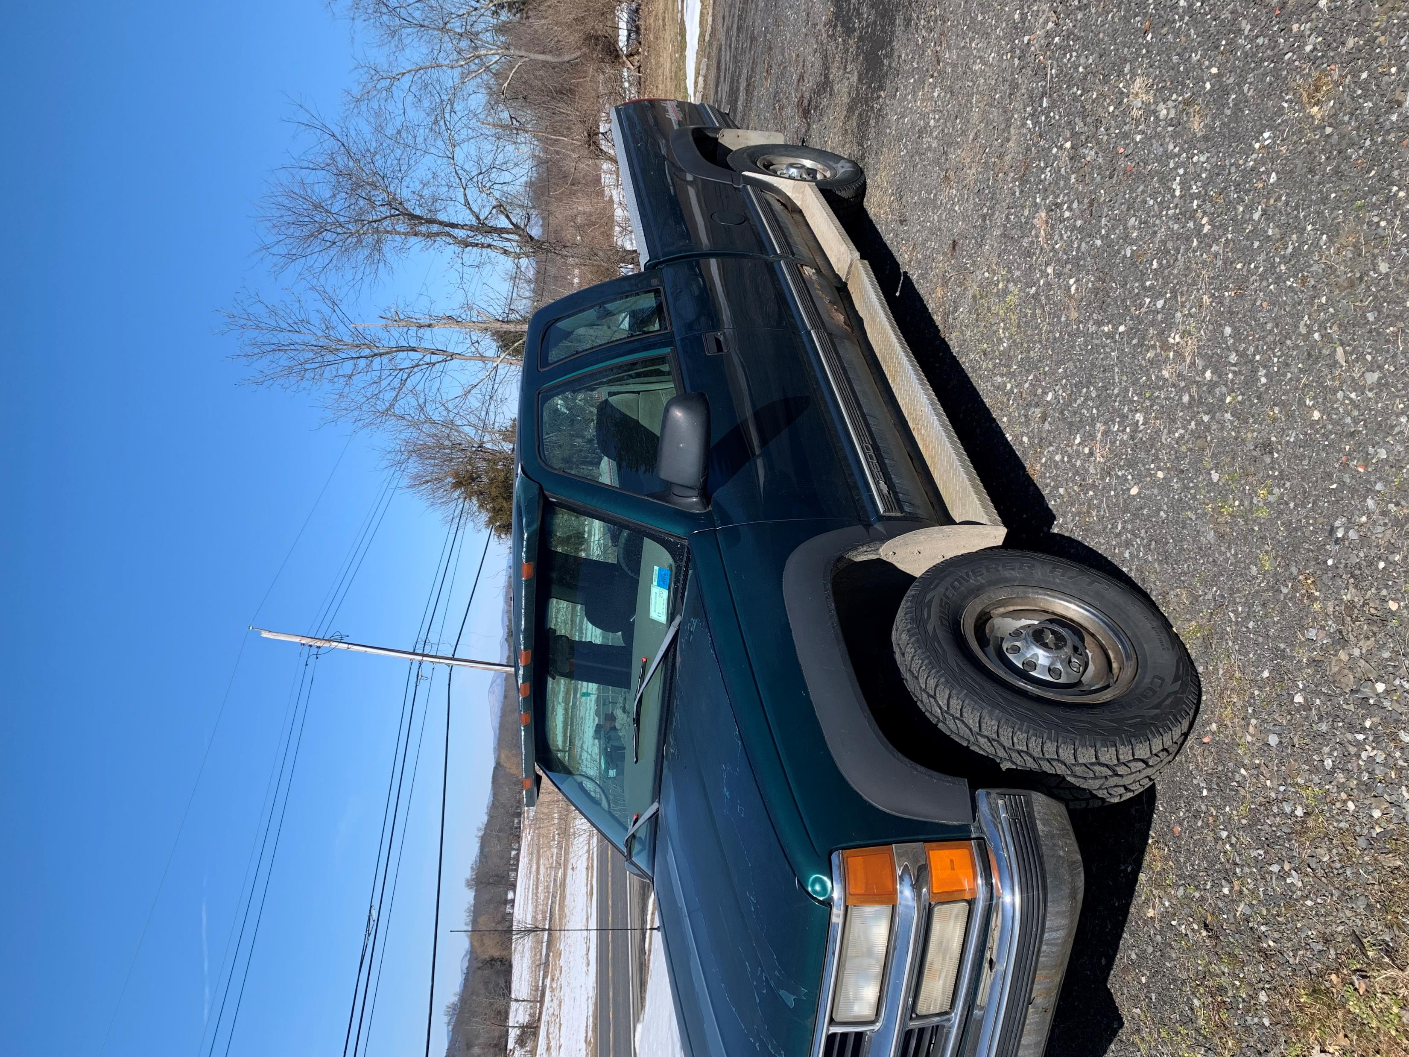
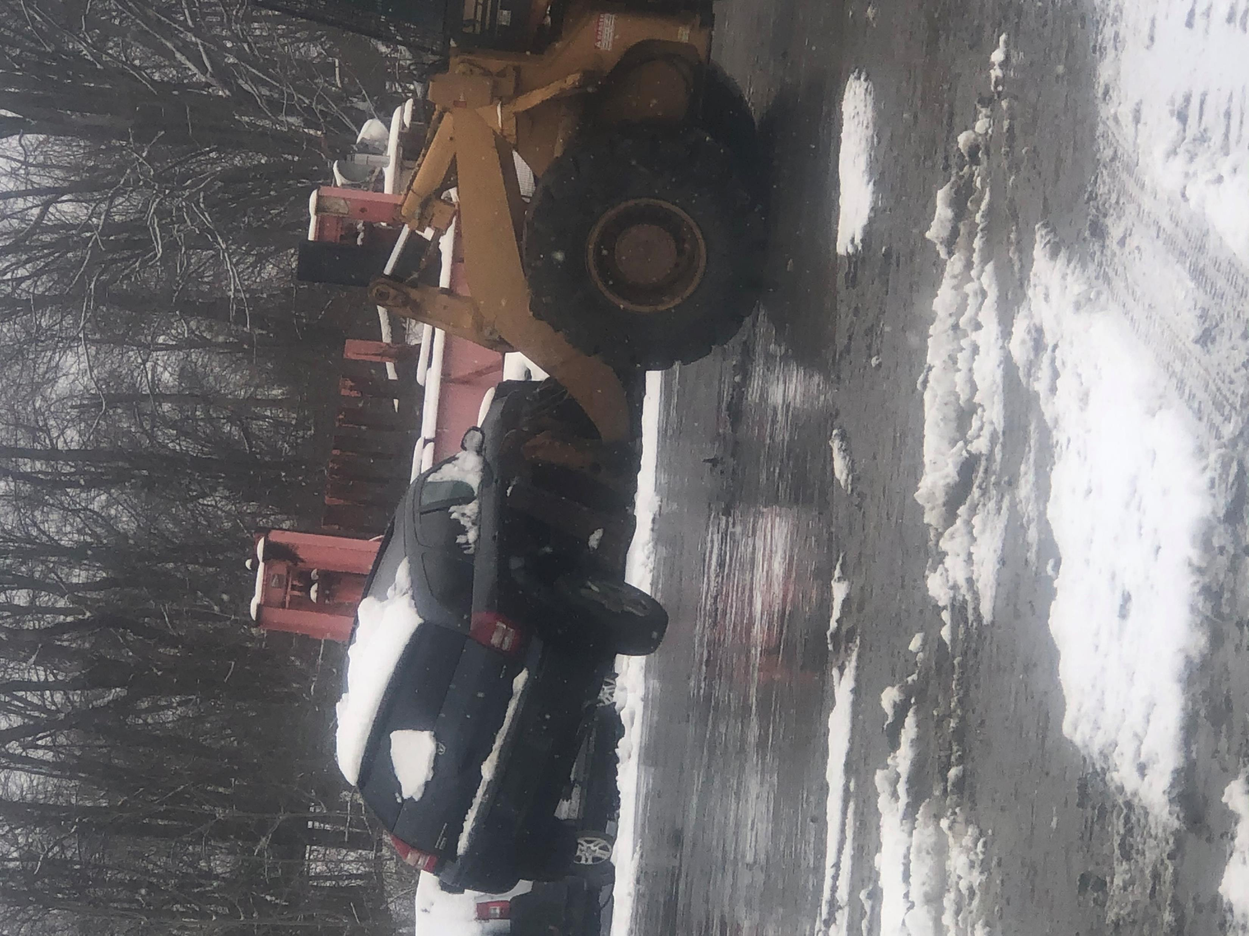
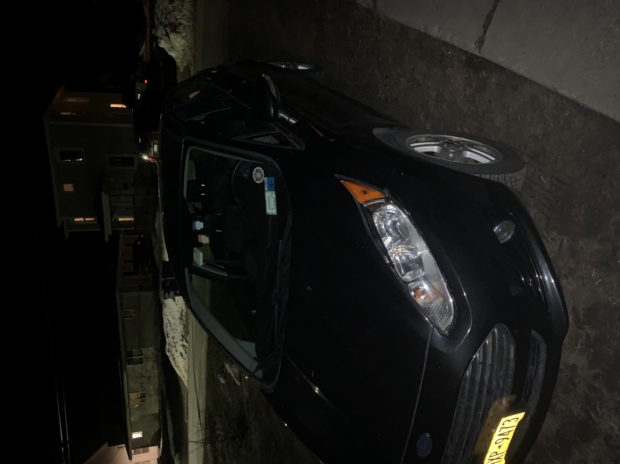
Garage Manager
Me: R. Chris Bendell
My Advisor: Dr. Supraja Gurajala

Slide 2


What is Garage Manager?
Primary Objective: Replace Spiral Notebooks
A single place to store all records pertinent to a vehicle
Simplistic
Get the job done well, without extra noise
Provide a continuous vehicle history
Assist in Financial Tracking
Help Users keep track of warranties
This was a Highly Recommended Feature from my Product Survey!

Slide 3





Technologies Utilized
Django Web Framework
Celery (python task queue)
Rabbit MQ (message broker)
Bootstrap4
SMTP/Gmail
Chart.js
SQLite 3
Languages:
Python
HTML
CSS
JavaScript
Stack Overflow

Slide 4


Demonstration

Slide 5





Opportunities for Future Expansion
Commercialization
Add functionality for use in a professional setting
Machine Learning Algorithms
Predicting Future Costs, Business Trends, Profit
HR Management
Add an application to track Employees and Customers
Upgrade Database
MongoDB?

Slide 6

Courses that made this Project Possible
Software Engineering (CIS405)
Database Systems (CIS 420)
Programming Languages (CIS443)

Slide 7
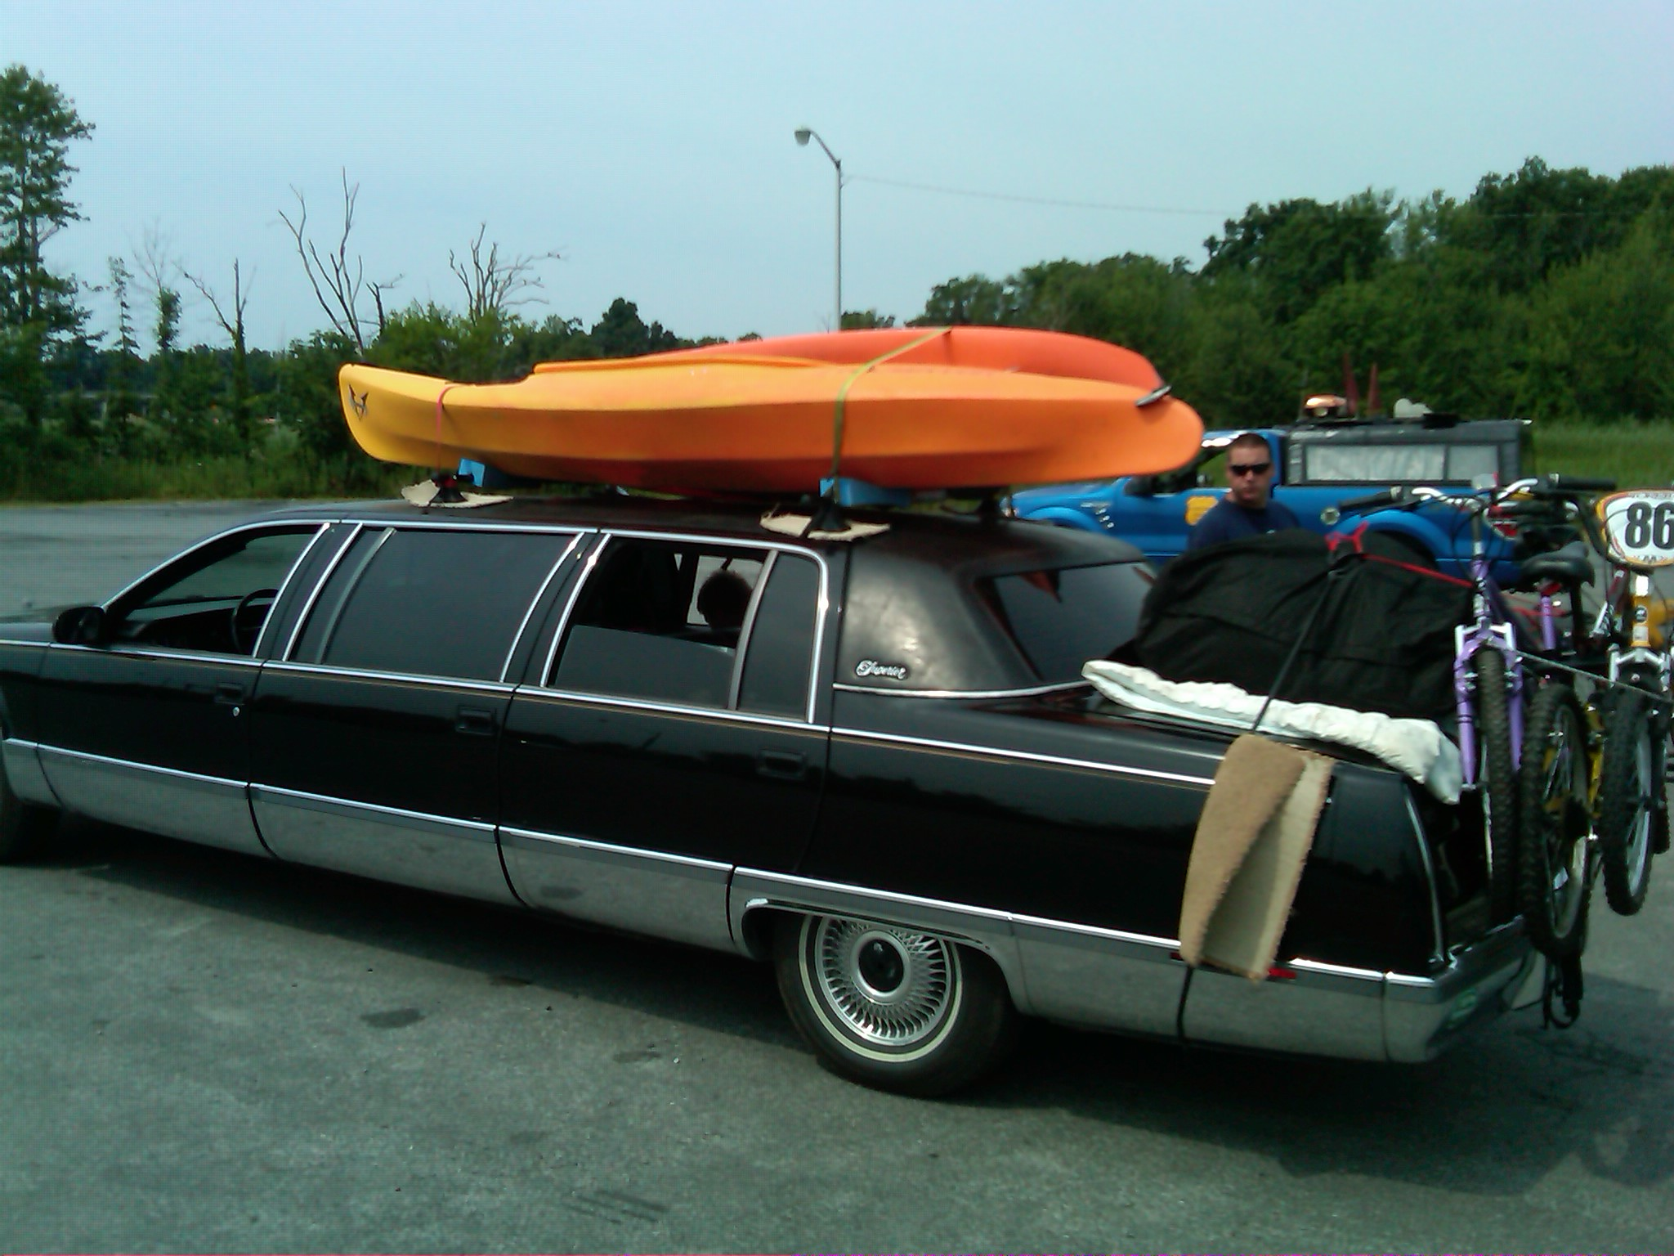
Thank You!
The Students!
Dr. Gurajala
Dr. Ladd
Dr. Grabowski
Dr. Lanz
Special Thanks to My Father:
Vehicle Photographer
Source of my Sense of Humor
The Reason Behind this Project

